Slide 1
Module 6.6 Secure development

Slide 2
Experimental Study
What factors most strongly influence the likely security of a new web site?
Developer training?
Developer team and commitment?
freelancer vs stock options in startup?
Programming language?
Library, development framework?
How do we tell?
Can we use automated tools to reliably measure security in order to answer the question above?

Slide 3
Approach
Develop a web application vulnerability metric
Combine reports of 4 leading commercial black box vulnerability scanners and
Evaluate vulnerability metric
using historical benchmarks and our new sample of applications.
Use vulnerability metric to examine the impact of three factors on web application security:
startup company or freelancers
developer security knowledge
Programming language framework

Slide 4
Data Collection and Analysis
Evaluate 27 web applications
from 19 Silicon Valley startups and 8 outsourcing freelancers
using 5 programming languages.
Correlate vulnerability rate with
Developed by startup company or freelancers
Extent of developer security knowledge (assessed by quiz)
Programming language used.

Slide 5
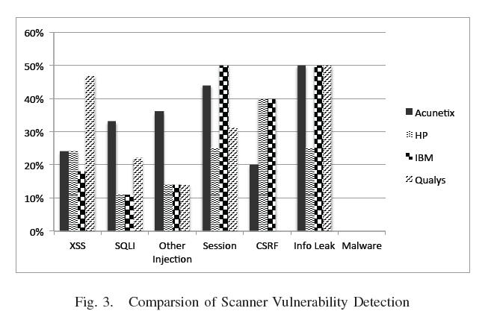
Comparison of scanner vulnerability detection

Slide 6
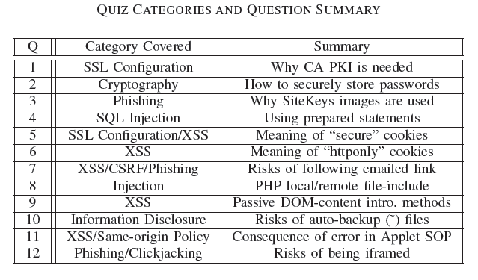
Developer security self-assessment

Slide 7
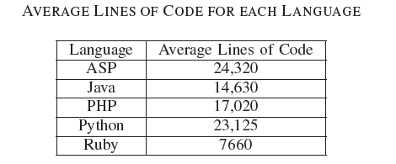
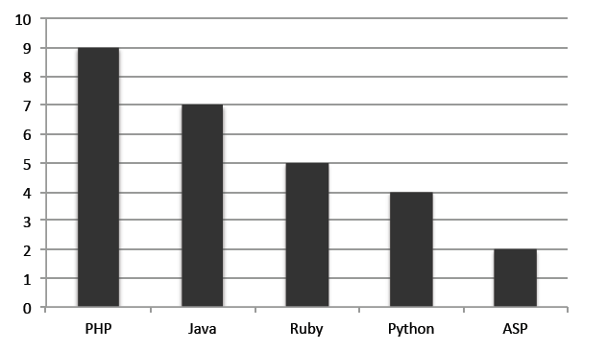
Language usage in sample
Number of applications

Slide 8
Summary of Results
Security scanners are useful but not perfect
Tuned to current trends in web application development
Tool comparisons performed on single testbeds are not predictive in a statistically meaningful way
Combined output of several scanners is a reasonable comparative measure of code security, compared to other quantitative measures
Based on scanner-based evaluation
Freelancers are more prone to introducing injection vulnerabilities than startup developers, in a statistically meaningful way
PHP applications have statistically significant higher rates of injection vulnerabilities than non-PHP applications; PHP applications tend not to use frameworks
Startup developers are more knowledgeable about cryptographic storage and same-origin policy compared to freelancers, again with statistical significance.
Low correlation between developer security knowledge and the vulnerability rates of their applications
Warning: don’t hire freelancers to build secure web site in PHP.

Slide 9
Additional solutions

Slide 10
Web Application Firewalls
Help prevent some attacks we discuss today:
Cross site scripting
SQL Injection
Form field tampering
Cookie poisoning
Sample products:
Imperva
Kavado Interdo
F5 TrafficShield
Citrix NetScaler
CheckPoint Web Intel
Notes:
List of examples keep changing every year.
These devices also function as SSL terminators to peek into SSL traffic.

Slide 11
Code checking
Blackbox security testing services:
Whitehatsec.com
Automated blackbox testing tools:
Cenzic, Hailstorm
Spidynamic, WebInspect
eEye, Retina
Web application hardening tools:
WebSSARI [WWW’04] : based on information flow
Nguyen-Tuong [IFIP’05] : based on tainting

Slide 12
Summary
SQL Injection
Bad input checking allows malicious SQL query
Known defenses address problem effectively
CSRF – Cross-site request forgery
Forged request leveraging ongoing session
Can be prevented (if XSS problems fixed)
XSS – Cross-site scripting
Problem stems from echoing untrusted input
Difficult to prevent; requires care, testing, tools, …
Other server vulnerabilities
Increasing knowledge embedded in frameworks, tools, application development recommendations

Slide 13
Lecture 6: Web Server Security
Total 6 Modules on Web Client Security
Module 6.1: Major Web server Threats: Command and SQL Injection Attacks
Module 6.2: CSRF – Cross-Site Request Forgery
Module 6.3: XSS – Cross-Site Scripting
Module 6.4: Defenses and Protections against XSS
Module 6.5: Finding Vulnerabilities
Module 6.6: Secure Development

